Slide 1


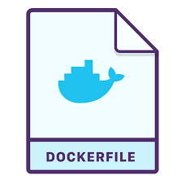
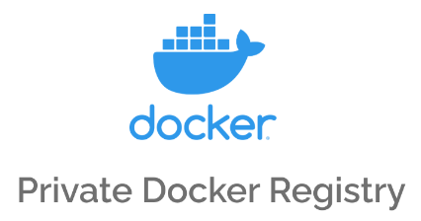












Zero Trust Security Architecture with Istio Service Mesh and OAuth 2.0 in Kubernetes
User Development processes
Source Code
Docker File
deploy
Istio Service Mesh
client
client
Service
JWT+TLS
mTLS
mTLS
mTLS
JWT+TLS
mTLS
External
API
Istio-proxy
Ingress
mTLS
Istio-proxy
HTTP, gRPC, TCP
Istio-proxy
Egress
Data plane
Control Plane Interface Traffic
Istiod
JWT
Certificate
Authority
Authentication
Policies
OAuth Server
Istiod
Network
Configuration
Authorization
Policies
JWKS
auth0.com
OAuth 2.0
API server
Configuration
Identity as a Service
(IaaS)
JWT
Control plane
External
client
JWT
CNI (Container Network Interface)
- control payload connection with eBPF (L3/L4 layer)
API
Calls
Lab Testing
CI/CD Automation with
Cluster Server #1
Cluster Server #2
Docker Registry Server

Slide 2
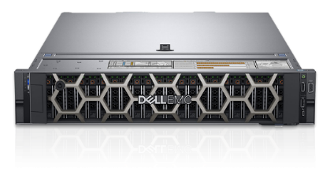





Edge-to-Core Service Mesh Testbed with Zero Trust Security Stack
Registry
Registry
- Docker Registry
- OAuth server
- Storage & ETC
Node 1
Node 2
Dell PowerEdge R640
Node 1
Spec:
Intel(R) Xeon(R) Silver 4214 CPU @ 2.20GHz
64GB system Memory
32GB DDR4 DIMM, speed up to 3200 MT/s
SCSI Disk 931GiB (999GB)
Embedded NIC: 4× 1GbE ports
- Kubernetes 1.32
- Istio v1.24 + Cilium v1.17
- dec-SMO application
- Grafana, Kiali for monitoring
Node 2
- Kubernetes 1.32
- Istio v1.24 + Cilium v1.17
- External Clusters
- External Client app.
- ETC
Source Code & Manifest files
GitLab Source Code
https://gitlab.nist.gov/gitlab/kyehwanl/zta-testbed

Slide 3

Access Servers
ssh to Server1
Access Info
Server 1: 5g1-comp1 ( 10.5.0.2)
Server 2: 5g1-comp2 ( 10.5.0.3)
Server 3: 5g1-comp3 ( 10.5.0.4)
ID: onfadmin, PW: 5Gtb@ctl
Oauth server (Keycloak)

Slide 4
Private Docker Registry
Pre-requistes
Place TLS credential for docker service
Place TLS credential for Kubernetes service

Slide 5
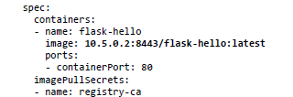
Private Docker Registry
Docker Image repository
Running on Server 1 (10.5.0.2) with TLS port 8443
How to Push a user image into the repo
Tag: docker tag <user-image>[:ver] <RegistryIP>:8443/<image-name>[:version]
git push/pull <RegistryIP>:8443/<image-name>[:version]
List the images
How to use in Kubernetes cluster
6-exmaples/flask-hello-service-deploy.yaml

Slide 6
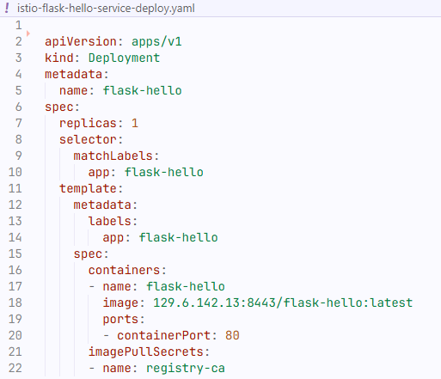
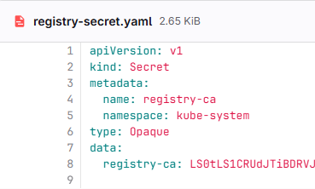
6-exmaples/istio-flask-hello-service-deploy.yaml
Image from
Private Docker Registry
6-exmaples/registry-secret.yaml
Credential
(TLS certs)

Slide 7
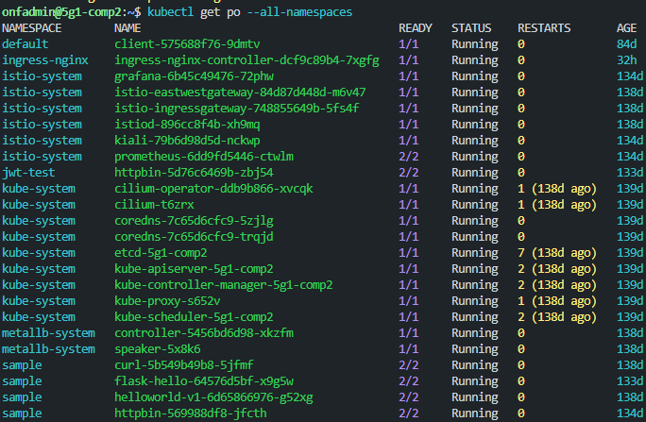
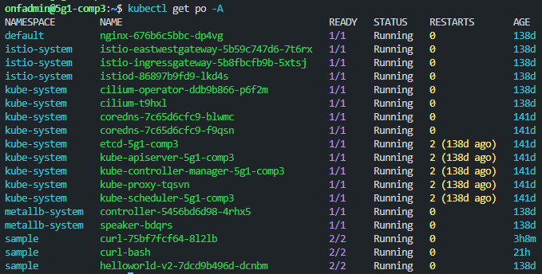
Cluster 1
Cluster 2

Slide 8
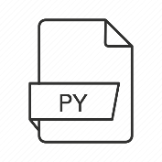
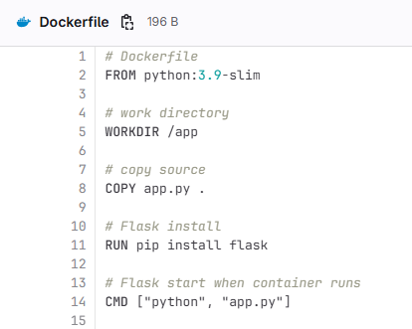
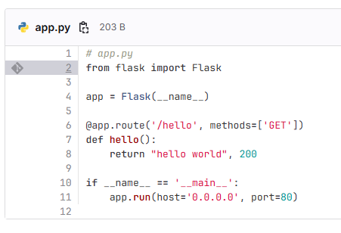

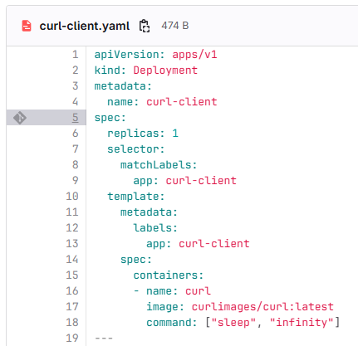
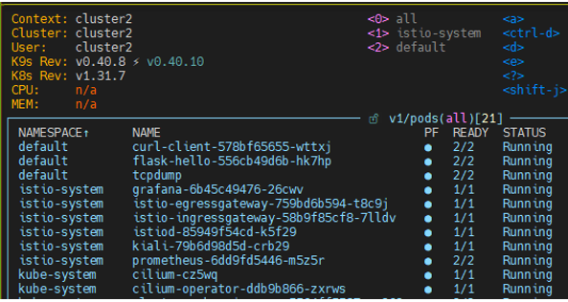
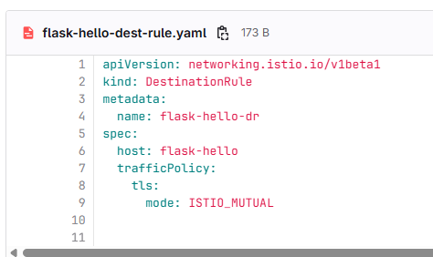
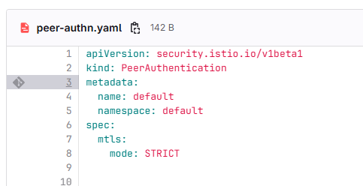
Simple Demo – curl-client and Websvr
GitHub, GitLab
Repository
Priv. Docker
Repository
Source Code
For WebSvr
Docker File
for WebSvr
Resource
provisioning
For curl-client
Resource
Provisioning
For Websvr-hello
Istio Service Mesh
curl-client
websvr-hello
Istio-proxy
mTLS
Istio-proxy
Istio-Peer Authentication
mTLS with ISTIO_MUTUAL policy

Slide 9
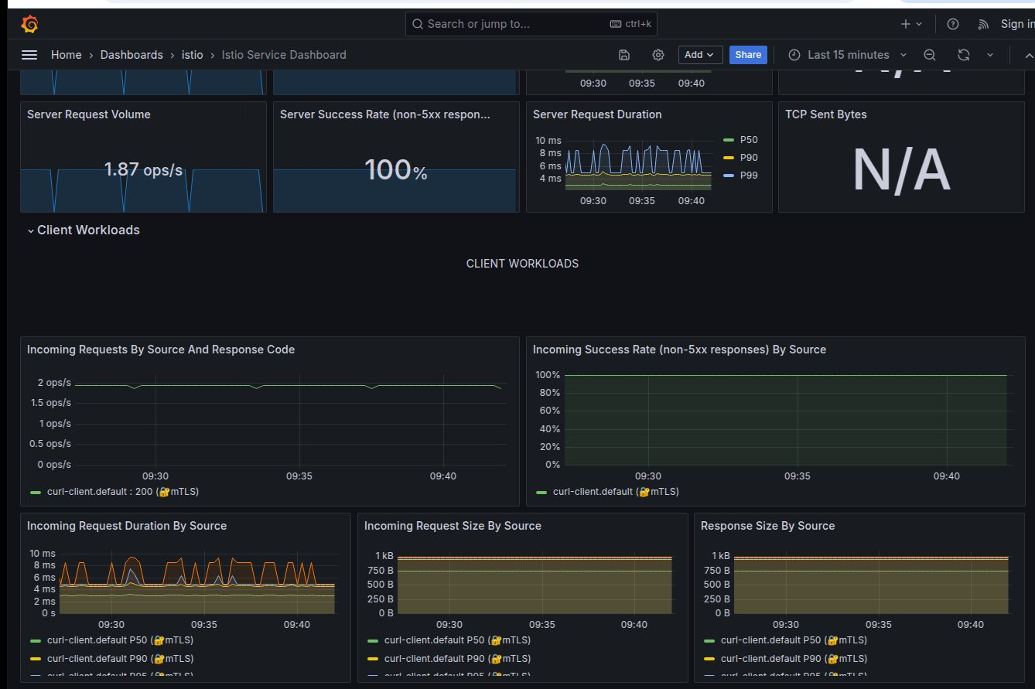
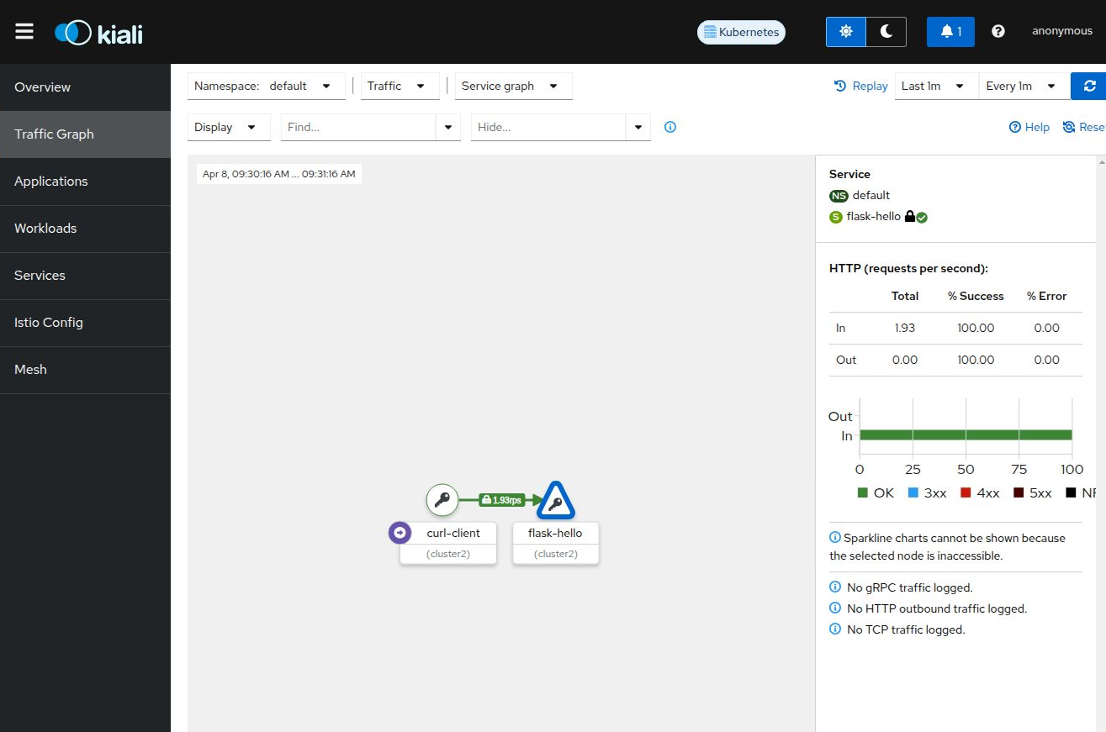
Grafana Monitoring tool
Kiali graphic generation tool

Slide 10
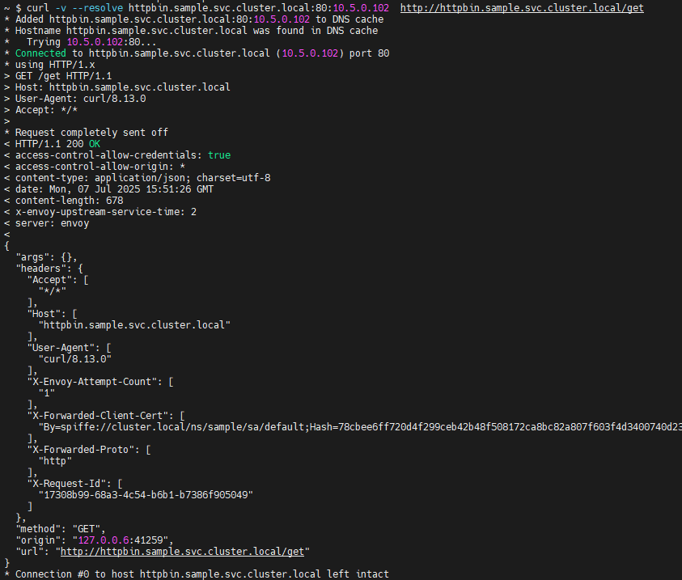
Inter-Cluster Connection Test
Connection test using curl
from Cluster2’s curl pod to httpbin service in cluster1
$ curl -v --resolve httpbin.sample.svc.cluster.local:80:10.5.0.102 http://httpbin.sample.svc.cluster.local/get

Slide 11
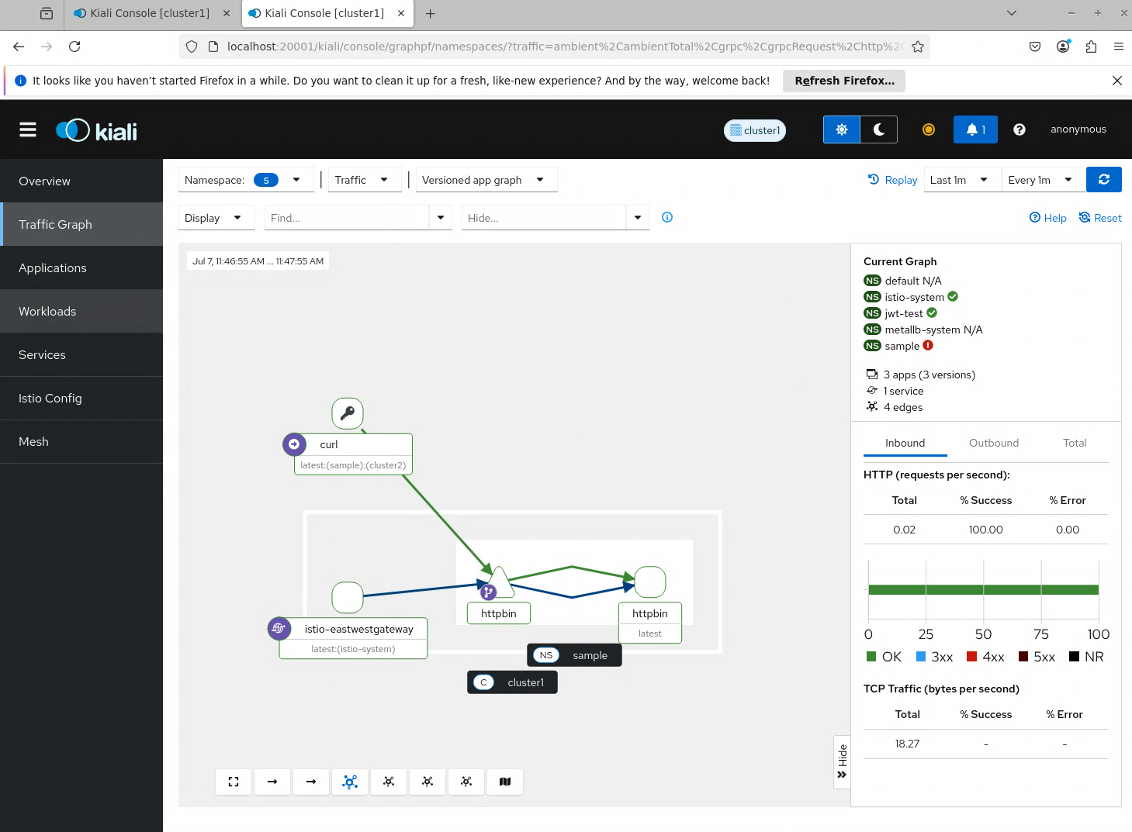
cluster2’s curl pod
cluster1 httpbin service

Slide 12
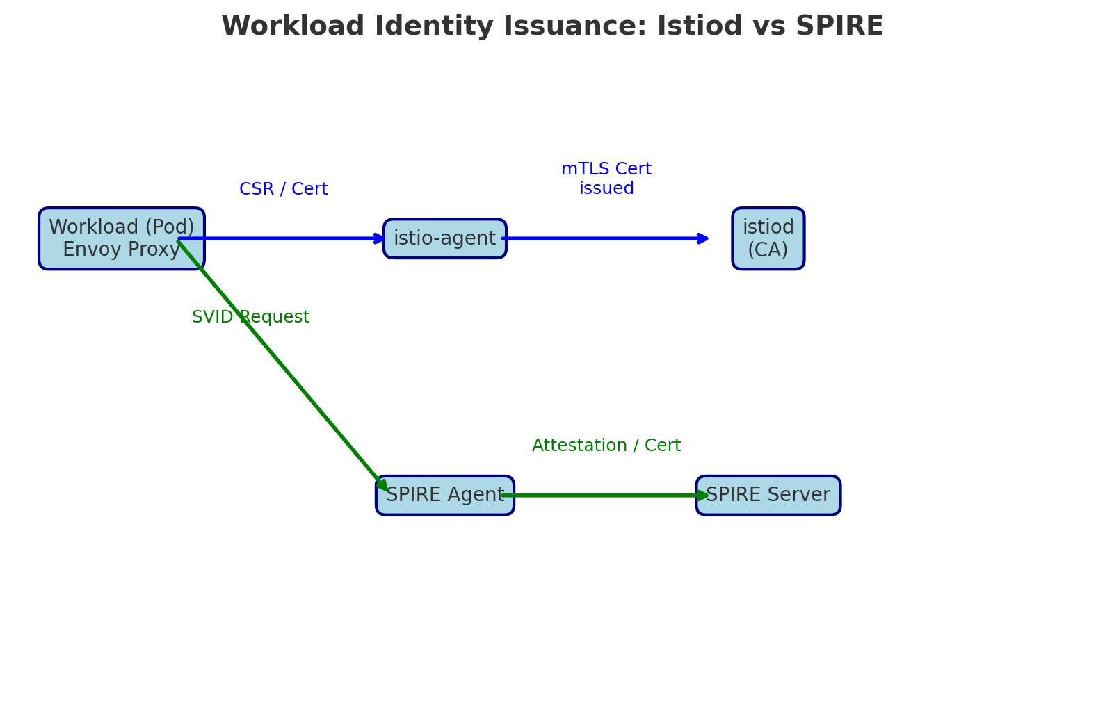
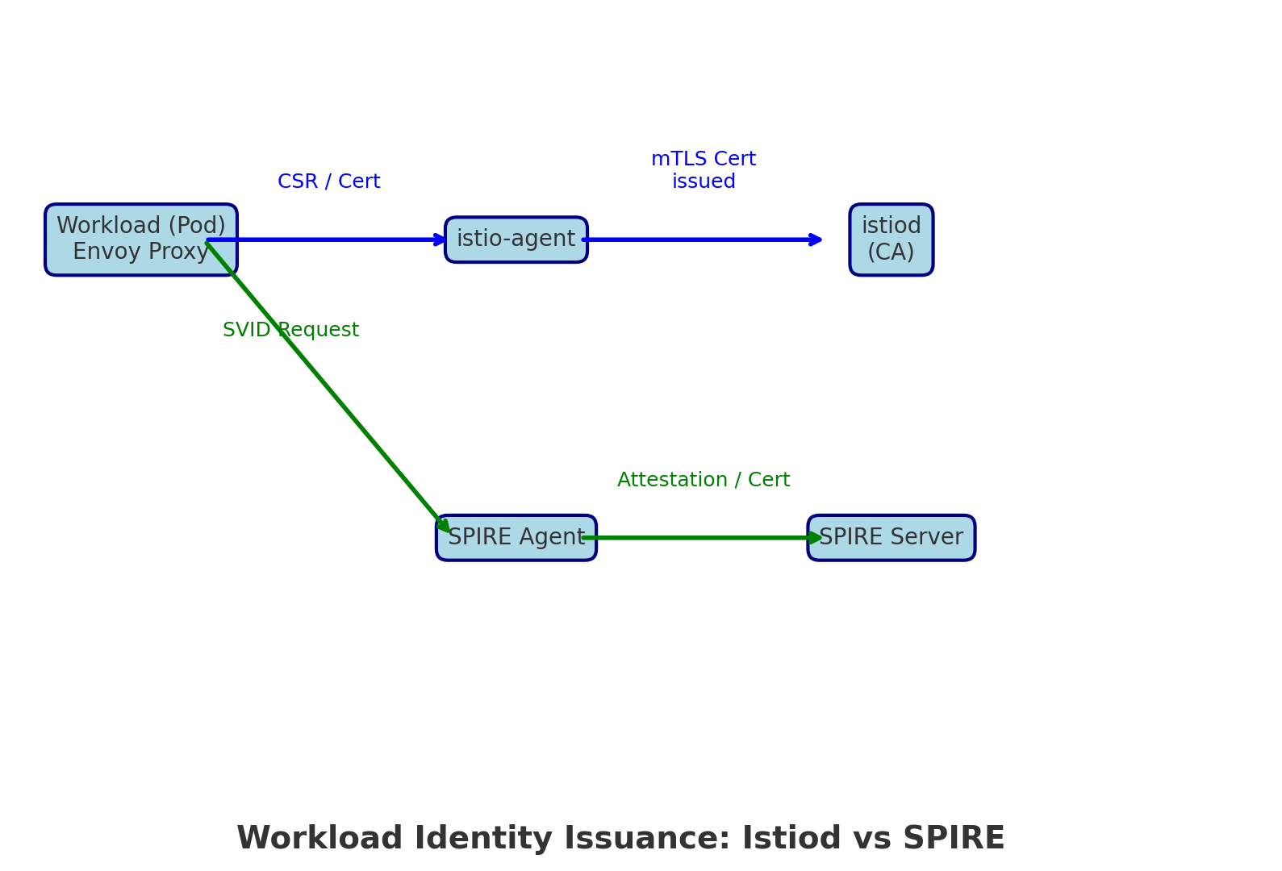

Slide 13
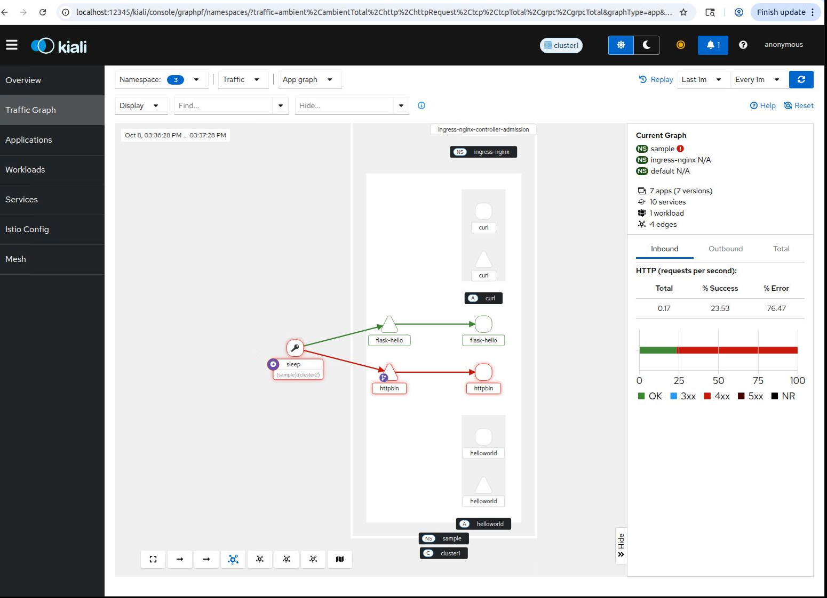

Slide 14
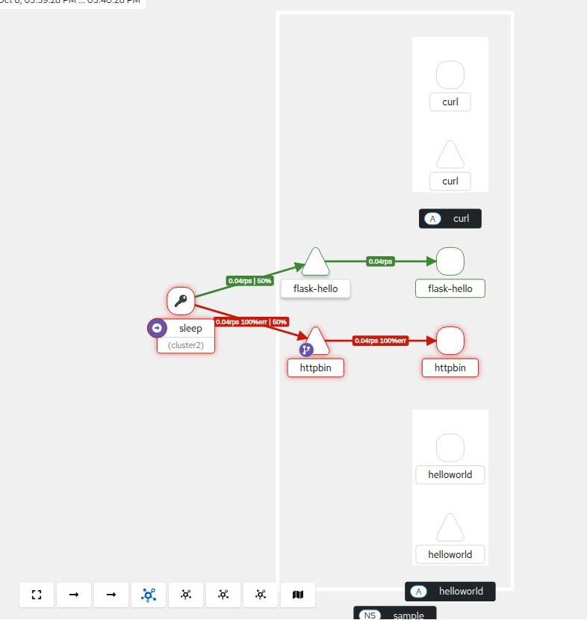

Slide 15
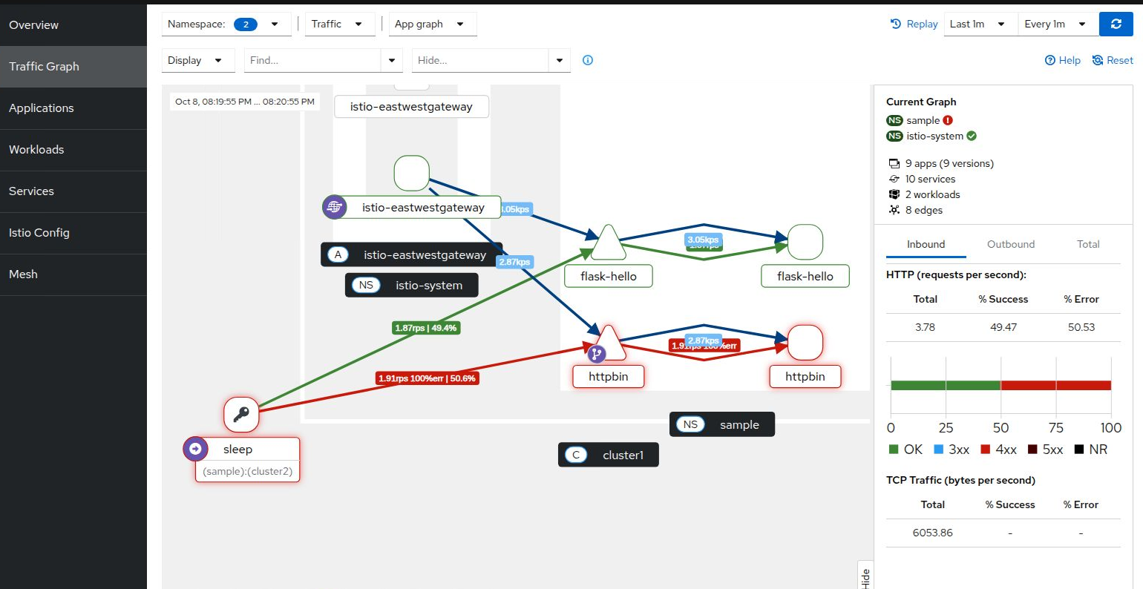

Slide 16
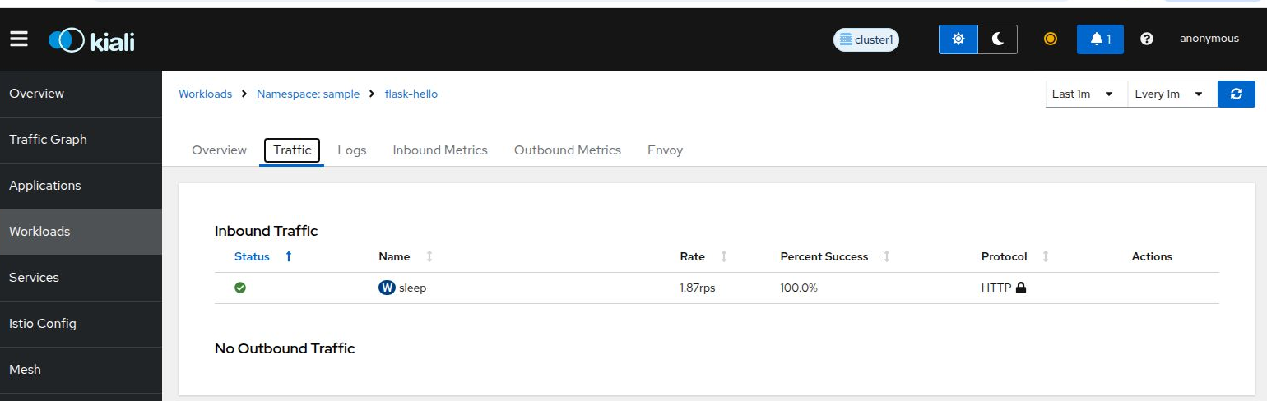
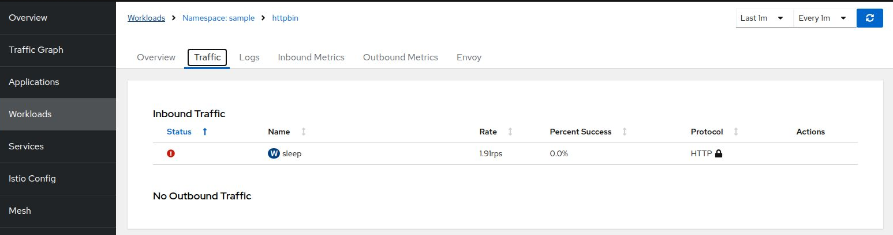

Slide 17
참고: Istio 환경에서 3xx 의미
VirtualService 의 redirect: 설정 시 301/302 응답을 인위적으로 보낼 수 있습니다.
Envoy Proxy가 URL 재작성(rewrite) 을 하면 내부적으로 3xx 대신 직접 200을 반환할 수도 있습니다.
302, 303, 307 은 특히 OAuth2 / OIDC 인증 플로우(로그인 리다이렉트)에서 자주 발생합니다.
401 vs 403 차이
401: JWT 서명/만료 등 검증 실패
403: JWT는 유효하지만 AP 조건 불일치(예: azp/aud/roles 미스매치 or 토큰 없음 + AP가 필수 요구)
코드 범위 | 설명 | 주용도
3xx | 리다이렉션 (Redirect) | 리소스 이동, 캐시 유효성, 인증/로그인 리다이렉트

Slide 18
EXTRA Slides

Slide 19
WebSvr-hello
Istio Service Mesh
curl-client
websvr-hello
Istio-proxy
mTLS
Istio-proxy
Image from
Private Docker Registry

Slide 20
Authentication, Authorization with mTLS setting
Peer Authentication
mTLS with ISTIO_MUTUAL policy

Slide 21
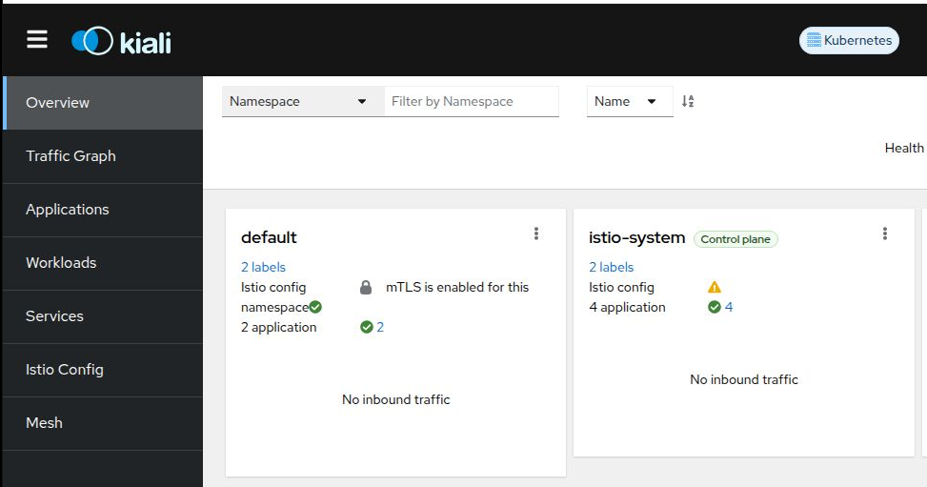
Visualization Traffic & Workloads Service with Kiali

Slide 22
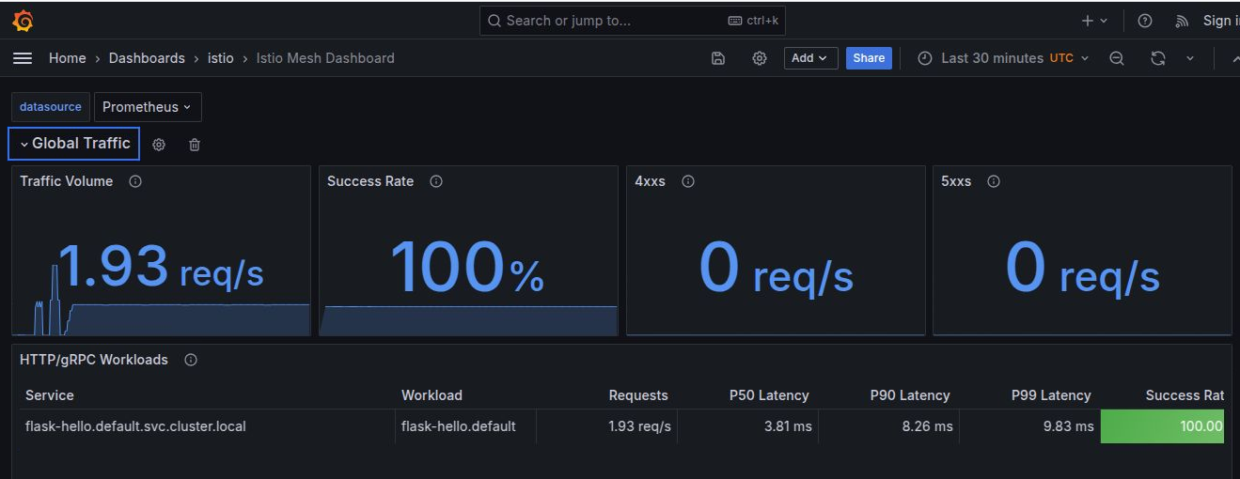
Grafana Observability

Slide 23
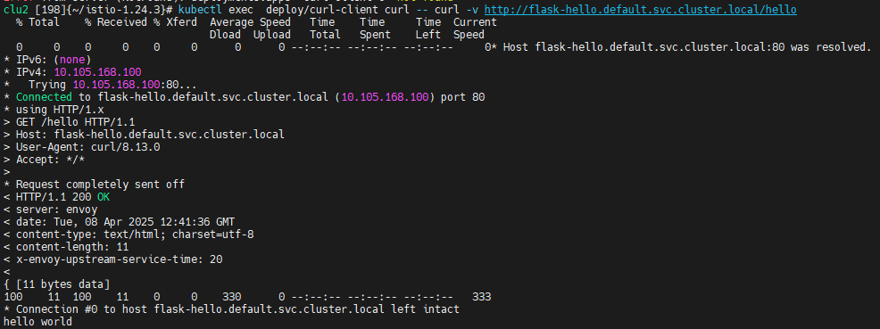
End-to-end traffic test

Slide 24
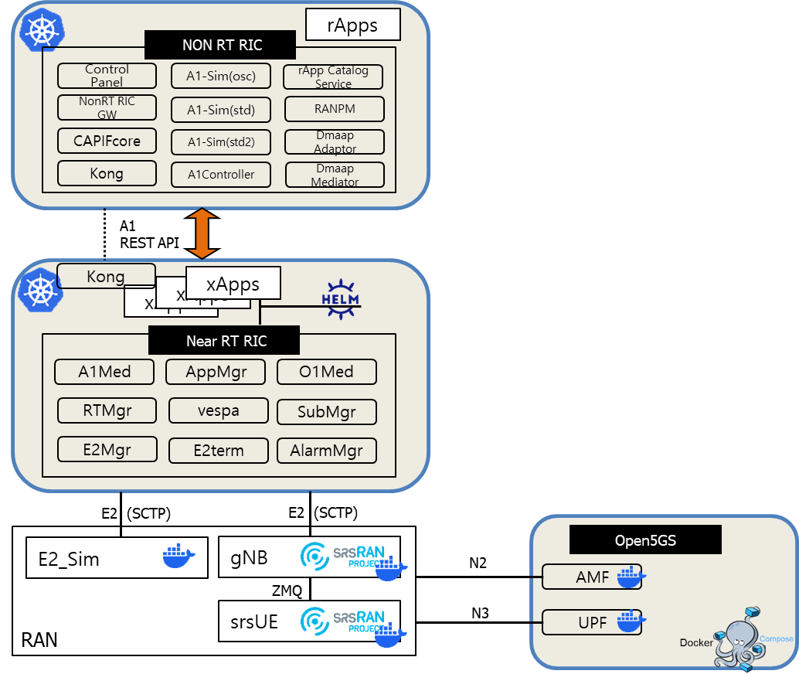

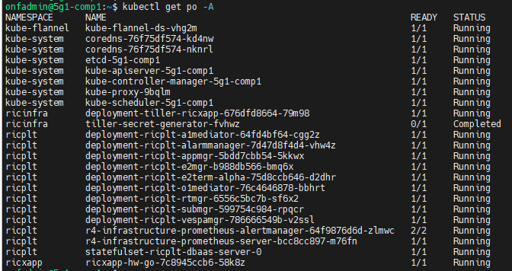
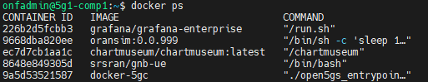
Two Standalone Testbeds : Accounts, Components info
PowerEdge
Comp Server1
(10.5.0.2)
PowerEdge
Comp Server3
(10.5.0.4)
Comp1,3 account
onfadmin: 5Gtb@ctl
Kubernetes Cluster- RIC
All running Docker Containers

Slide 25



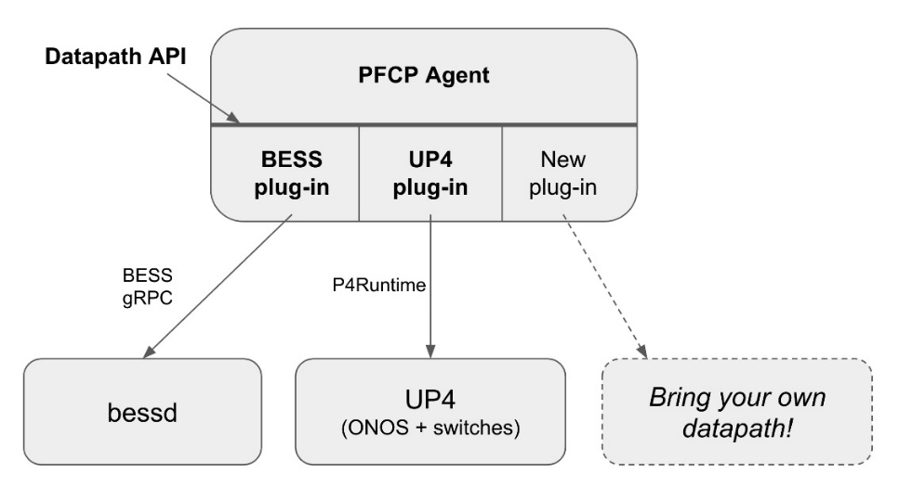

UPF-BESS Development Cycle at a glance (아이콘 참조용)
GitHub
Repository
Automation
DockerHub
Repository
https://github.com/omec-project/upf
Automatic Image Build supported when linked each other
omecproject/upf-epc-bess:master-9a4d86c
Development Chain
Source
Code
Docker
File
Docker
Image (bin)
pfcpiface(bin)
Makefile
bess(bin)
Docker Image:
Instance Run by Pulling Binary Docker images
UPF helm char includes
URLs for Docker images
pfcpiface(bin)
Helm Chart
Repository
Go module
https://charts.aetherproject.org
Distribution Chain
python gRPC
Go gRPC
Pull docker images
Construct Kubernetes Cluster
C++ gRPC & Core
bess(bin)

Slide 26
Deployment Strategies with GitHub and Docker (아이콘 참조용)
GitHub
Repository
Automation
DockerHub
Repository
Automatic Image Build supported when linked each other
Source
Code
Source
Code
Docker
File
Docker
Image (bin)
Compile & Install
Build & Instance
Instance
Linux OS
Linux & Windows & MAC
Linux & Windows & MAC
Installation by compile
Build Docker Images
Pulling Images
Library Dependency
Container Instantiations
Container Instantiations
Configurations
Configurations
Configurations
Source Code & Compilation:
General way of Development and distribution
Dockerfile:
enable to make images and containerized based on this image
Docker Image:
Instance Run by Pulling Binary Docker images

Slide 27




Automation using Docker-compose (NIST-BGP-SRx) (아이콘 참조용)
NIST-BGP-SRx Source Code & Dockerfile
ExaBGP-SRx Source Code & Dockerfile
SRx Server
Container
Quagga Host
Container
GoBGP-SRx Source Code & Dockerfile
Protocol and Documentation
Git Clone repository
QuaggaSRx
Container
Wireshark
Container
RPKI-RTR-SVR
Container
GoBGP-SRx Container
Docker Compose
Build all images and containers
Perform service integration
BgpsecIO
Container
Centos Client Container
Pull docker images
Centos:7 Images
Golang:latest Images
ExaBGP-SRx Container
quagga:latest Images
Monitoring tools & etc
Images

